Slide 1
Wide & Deep Learning for Recommender Systems
Arnab Dana
Department of Computer Science and Engineering
National Institute of Technology
Uttarakhand, India

Slide 2
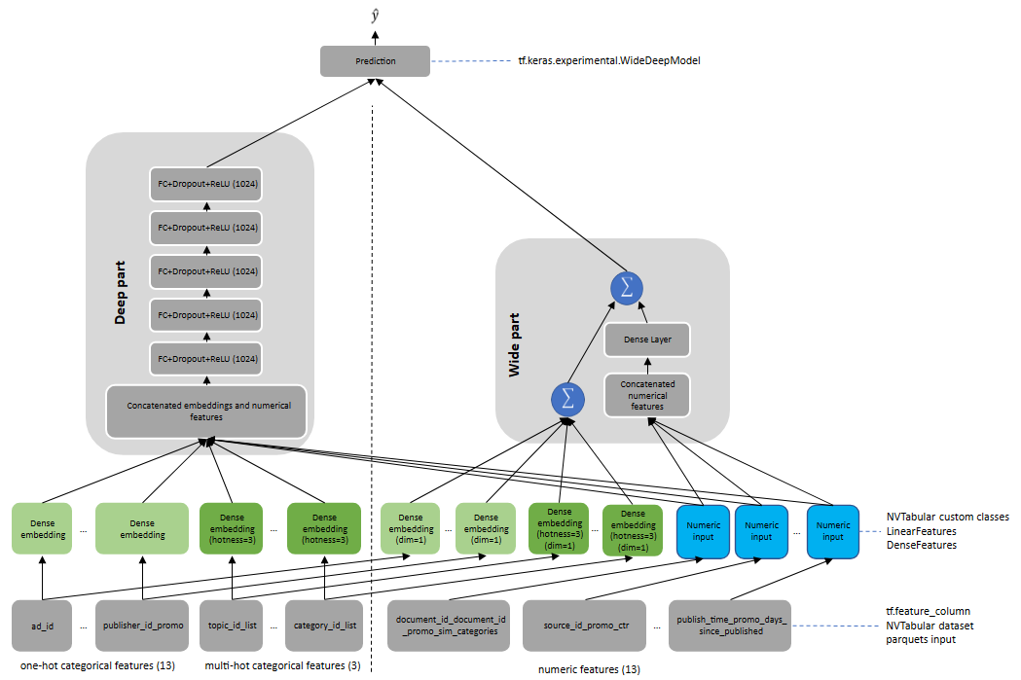

Slide 3
ABSTRACT
Recommender systems rely on memorizing past user behavior to suggest similar items. This works well when we have a lot of data, but not so well for new users or unseen items. Deep learning can handle these situations better, but it can also recommend irrelevant things.
Google researcher has proposed a new approach called Wide & Deep, which combines both methods. It uses memorization for known user-item interactions and deep learning to explore new possibilities. This leads to more accurate recommendations, especially for new users or items.
The researchers tested their method on Google Play with great success, significantly increasing app installations compared to traditional methods.

Slide 4
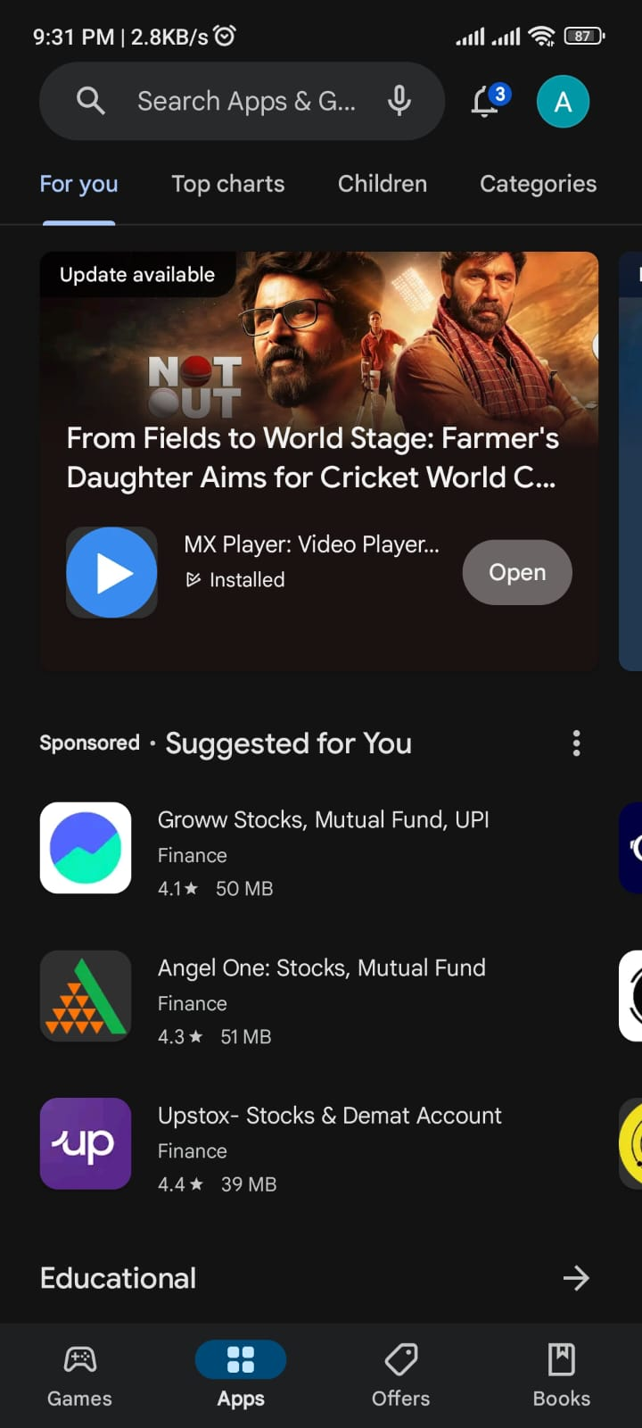
Example of Google Play Store recommendations

Slide 5
Table Of Contents
Introduction
Recommender System Overview
Wide & Deep Learning
The Wide Component
The Deep Component
Joint Training Of Wide & Deep Model
System Implementation
Experiment Results

Slide 6
Introduction
Recommender systems play a crucial role in modern online platforms by assisting users in discovering relevant items based on their preferences and behaviors. These systems operate similar to search ranking systems, where user information and context are used to generate a ranked list of items. Achieving an effective recommender system involves balancing two key aspects: memorization and generalization.
Memorization involves learning from past user-item interactions to recommend items that are directly relevant to the user's previous actions. On the other hand, generalization explores new patterns and combinations of features, improving the diversity of recommendations.

Slide 7
Introduction
In this paper, Author address the challenge of creating a robust recommendation system using a methodology called Wide & Deep learning. This approach combines the strengths of memorization, achieved through cross-product feature transformations, and generalization, facilitated by deep neural networks with embeddings. We focus on optimizing app recommendations for the Google Play store, demonstrating the applicability of our approach to various recommender systems.
Their contributions include introducing the Wide & Deep framework, implementing it for real-world applications on Google Play, and open-sourcing our implementation for broader usage. Through empirical evaluation, we showcase the effectiveness of our approach in enhancing app acquisition rates while meeting stringent performance requirements.

Slide 8
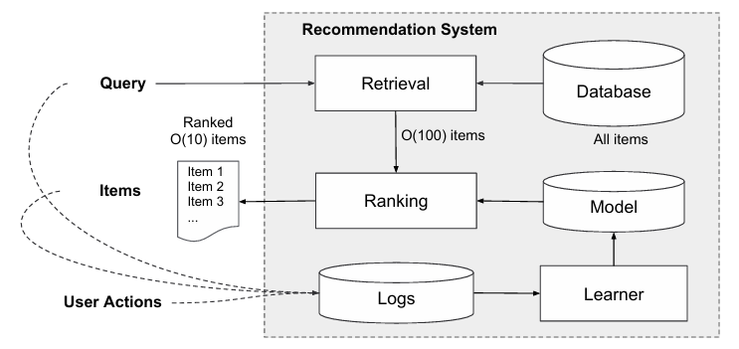
Recommender System Overview

Slide 9
Query Generation: The query generation process in app stores involves gathering user and contextual data like location, demographics, search history, and time to generate relevant search queries when a user visits.
Retrieval: The retrieval system in app stores employs machine-learned models and predefined rules to narrow down millions of apps to a shortlist that best matches the user's query.
Ranking: The ranking system assigns scores to candidate apps based on user actions likelihood, considering user and contextual features as well as app attributes. the ranking system ranks all items by their scores. The scores are usually P(y|x), the probability of a user action label y given the features x, including user features (e.g., country, language, demographics), contextual features (e.g., device, hour of the day, day of the week), and impression features (e.g., app age, historical statistics of an app).
Learning: User actions, queries, and impressions are recorded to train models enhancing the accuracy of retrieval and ranking systems over time.

Slide 10
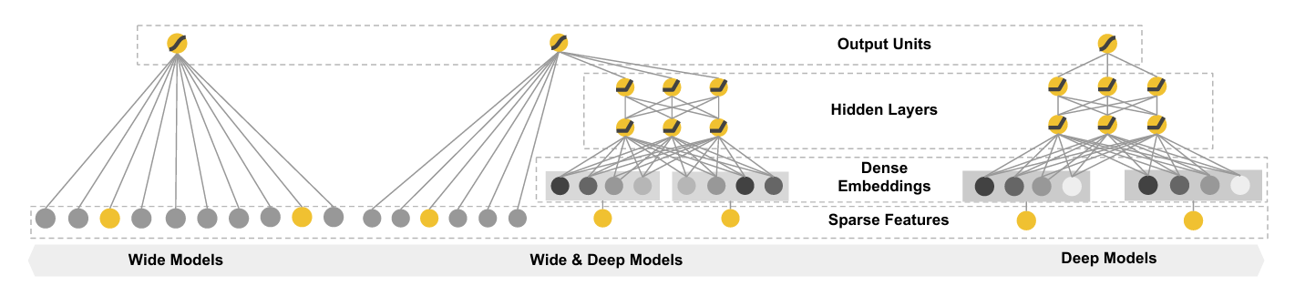
Wide & Deep Learning
The spectrum of Wide & Deep models

Slide 11
The Wide Component
Linear Model: This part acts like a regular math equation where various features (x1, x2, etc.) are multiplied by weights (w1, w2, etc.) and summed up to make a prediction (y). These features can be raw user data or interactions transformed in a specific way.
Feature Engineering: This step involves creating new features by multiplying existing features together. For instance, if a user likes horror movies and comedies, this component might create a new feature to indicate the user’s preference for “horror comedy” movies.
y = w^{T}x+b
y is the prediction, x = [x₁, x₂, x_{d}] is a vector of d features, w = [w₁, w₂, w_{d}] are the model parameters and b is the bias.

Slide 12

The feature set includes raw input features and transformed features. One of the most important transformations is the cross-product transformation, which is defined as:
where c_{ki} is a boolean variable,
that is 1 if the i-th feature is part of the k-th transformation Ø_{k}
0 otherwise
For binary features, a cross-product transformation (e.g., AND (gender=female, language=en)) is 1 if and only if the constituent features (gender=female and language=en) are all 1, and 0 otherwise.
This captures the interactions between the binary features, and adds nonlinearity to the generalized linear model.

Slide 13

The Deep Component
Embeddings: Categorical features (like user demographics or app categories) are converted into numerical representations called embeddings. This is because machines work better with numbers than text.
Neural Network: These embeddings are fed into a multi-layered neural network. Each layer performs calculations on the data from the previous layer to learn complex patterns from the data.
These low-dimensional embedding vectors are then fed into the hidden layers of a neural network in the forward pass(feed-forward neural network).
Specifically, each hidden layer performs the following computation:
where l is the layer number and f is the activation function, often rectified linear units (ReLUs). a^{(l)}, b^{(l)}, and W^{(l)} are the activations, bias, and model weights at l-th layer.

Slide 14
Joint Training Of Wide & Deep Model
Joint Training: Both the wide linear model and the deep neural network are trained simultaneously. This allows them to learn from each other and improve the overall accuracy of the recommender system.
Weighted Sum: The outputs from both parts are then combined using a weighted sum. This means the system considers the influence of both the memorized feature interactions (wide component) and the learned patterns from data (deep component) to make the final recommendations.
For a logistic regression problem, the models prediction is:
where Y is the binary class label, σ(.) is the sigmoid function, Ø(x) are the cross product transformations of the original features x, and b is the bias term. w_{wide} is the vector of all wide model weights, and w_{deep} are the weights applied on the final activations a^{(lf)}.

Slide 15
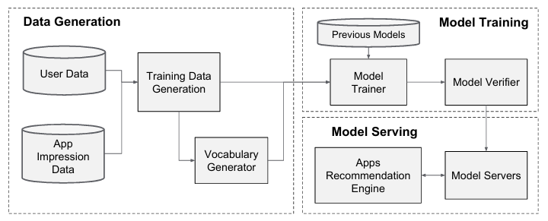
System Implementation
Apps recommendation pipeline overview

Slide 16
Data Generation
Data Collection: User and app impression data are collected over a specific period. An impression refers to an instance where an app was displayed to a user.
Labeling: Each data point (impression) is assigned a label. The label is 1 if the user installed the app after seeing it, and 0 otherwise.
Vocabulary Creation: The system creates a vocabulary to represent categorical features (e.g., app categories, user locations) with numerical IDs. This is because machines process numbers more efficiently than text.
Feature Normalization: Continuous numerical features (e.g., user age) are converted to a scale between 0 and 1.

Slide 17
Model Training
Model Structure: The Wide&Deep model consists of two parts: a wide linear model and a deep neural network (refer to the image).
Data Preprocessing: The training data and vocabulary are fed into the model. Sparse features (e.g., user ID, app ID) and dense features (e.g., normalized user age) are generated.
Wide Component: This component multiplies existing features together to create new features. For instance, it might create a feature to indicate a user’s preference for “racing games” if the user has installed racing and car game apps in the past.
Deep Component: Categorical features are converted into embedding vectors. These embeddings are processed by a multi-layered neural network to identify complex patterns in the data.

Slide 18
Model Training
Combining Components: The outputs from both the wide model and deep neural network are combined.
Training the Model: The entire Wide&Deep model is trained on a massive dataset (over 500 billion examples in this case).
Warm Starting: When a new dataset is available, the system utilizes a warm-starting technique. This means it reuses the weights and embedding vectors learned from the previous model as a starting point, making the training process faster and more efficient.

Slide 19
Model Serving
Request Processing: When a user searches for an app, the app retrieval system generates a list of candidate apps. User features (e.g., demographics) are also provided.
Model Scoring: The Wide&Deep model scores each candidate app based on its relevance to the user.
App Ranking: The apps are ranked based on their scores, with the most relevant apps appearing at the top.
Serving Results: The ranked list of apps is presented to the user.
Performance Optimization: To ensure fast response times (ideally under 10 milliseconds), the system utilizes multithreading to process multiple app scores simultaneously.

Slide 20
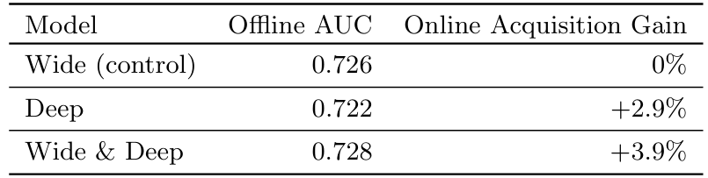
Experiment Results
Offline & online metrics of different models
Ran live online experiments using an A/B testing framework for 3 weeks.
Control group (1% of users) received recommendations from the previous optimized wide-only logistic regression model.
Experiment group (1% of users) received recommendations from the Wide & Deep model, showing a +3.9% improvement in app acquisition rate on the main landing page (statistically significant).

Slide 21
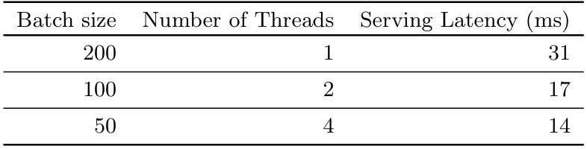
Compared with a group using only the deep part of the model, Wide & Deep had a +1% gain (statistically significant).
Wide & Deep model showed slightly higher AUC in offline evaluation.
The impact was more significant in online traffic due to the system's ability to generate new exploratory recommendations and learn from user responses.
Serving latency vs. batch size and threads
The table shows that using multithreading to split batches into smaller sizes significantly reduced the latency of scoring apps by recommender servers.

Slide 22
Conclusion
Memorization and generalization are both important for recommender systems. Wide linear models can effectively memorize sparse feature interactions using cross-product feature transformations, while deep neural networks can generalize to previously unseen feature interactions through low-dimensional embeddings. We presented the Wide & Deep learning framework to combine the strengths of both types of models. We productionized and evaluated the framework on the recommender system of Google Play, a massive-scale commercial app store. Online experiment results showed that the Wide & Deep model led to significant improvement in app acquisitions over wide-only and deep-only models.

Slide 23
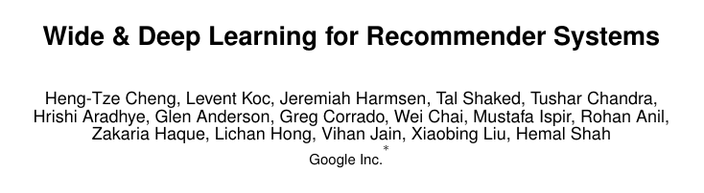
Reference
1606.07792.pdf (arxiv.org)

Slide 24
Thank You

